Slide 1
Contract Monthly Claim System (Final POE – Part 3)
Developed by: Imraan Nordien
Student No: St1034419
Course: PROG6212
Institution: Varsity College
Date: 21 November 2025

Slide 2
Project Overview
Purpose: Automates monthly contract claim process for lecturers Streamlines approvals and payments across roles Improves accuracy, reduces manual work, enhances security | Core Technologies: ASP.NET Core MVC, C# Entity Framework Core, SQL Server (LocalDB) Sessions for authentication Bootstrap and Razor Views

Slide 3
System Users
Role | Function
Lecturer 📄 | Submit claims, upload documents, view claim history
Programme Coordinator (PC) ✅ | Verify claims submitted by lecturers
Academic Manager (AM) ✔️ | Approve verified claims
HR 🛠️ | Manage users, set hourly rates, generate reports

Slide 4
Lecturer Feedback & Improvements
Feedback | Action Taken
Lecturers should not define hourly rates | HR sets rates automatically ✅
Files stored without validation | Added type & size validation ✅
Generic error messages | Detailed user feedback using TempData ✅
Missing input validation | Added form validation & unit tests ✅
Managers could approve before verification | Workflow: Pending → Verified → Approved ✅
Approved claims stayed in Pending | Filtered views for Approved/Rejected claims✅

Slide 5
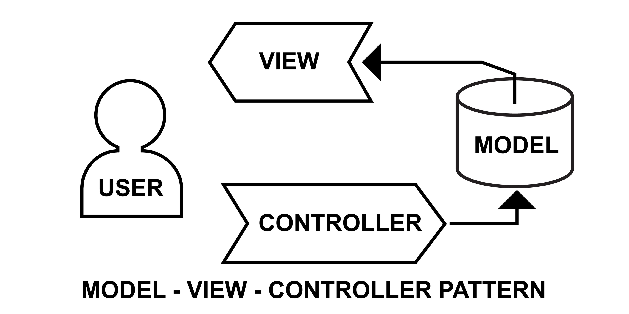
System Architecture
Controllers handle role-based logic (Lecturer, PC, AM, HR)
Models represent Users and Claims in DB
Views are Razor pages for interaction and display
Sessions manage login and access
Database (SQL Server + EF Core) stores persistent data

Slide 6
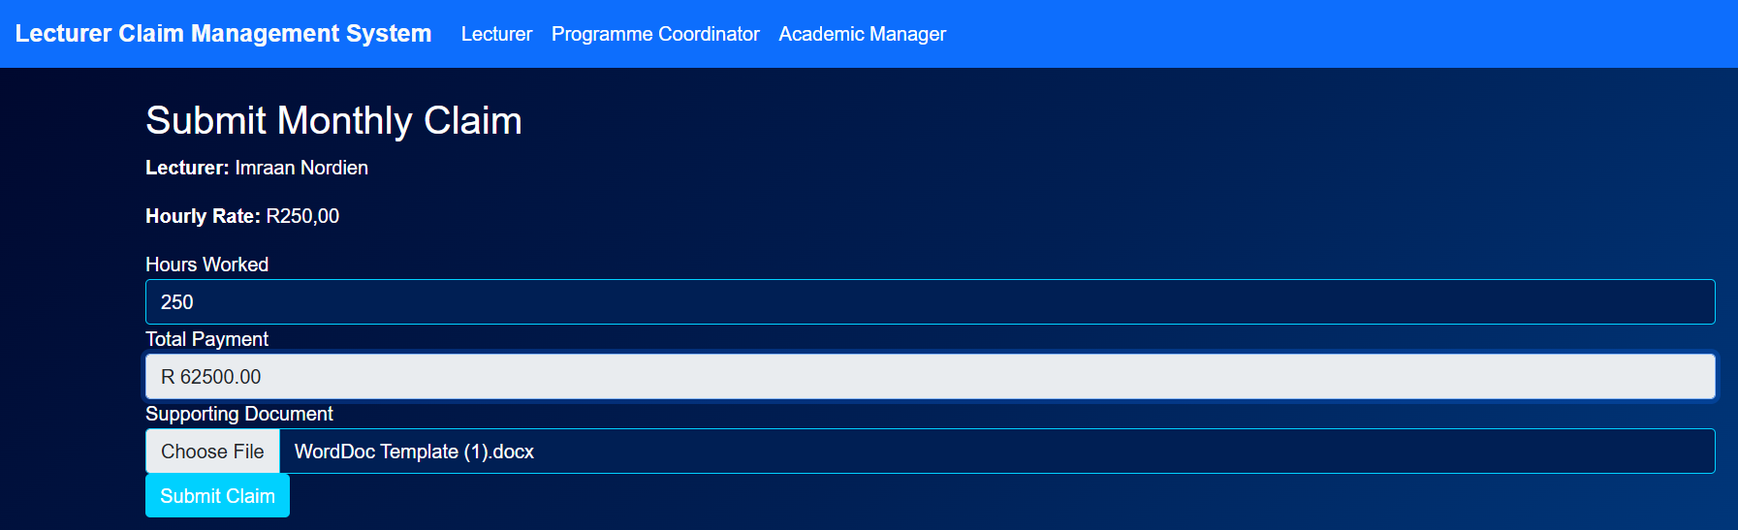
Lecturer View
Login restricted to Lecturers via session
Auto-calculation of total pay (Hours × Rate)
File upload with validation (PDF, DOCX, XLSX)
Claims stored in SQL Database
Claim history viewable only by lecturer

Slide 7
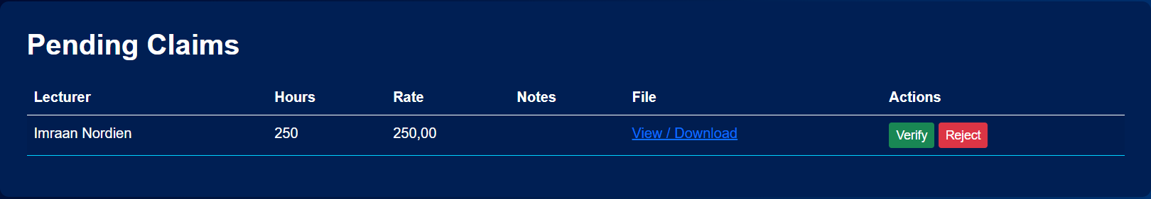
Programme Coordinator (PC) View
View Pending Claims
Verify or Reject claims
Role-restricted access
Verified claims automatically move to Academic Manager view

Slide 8
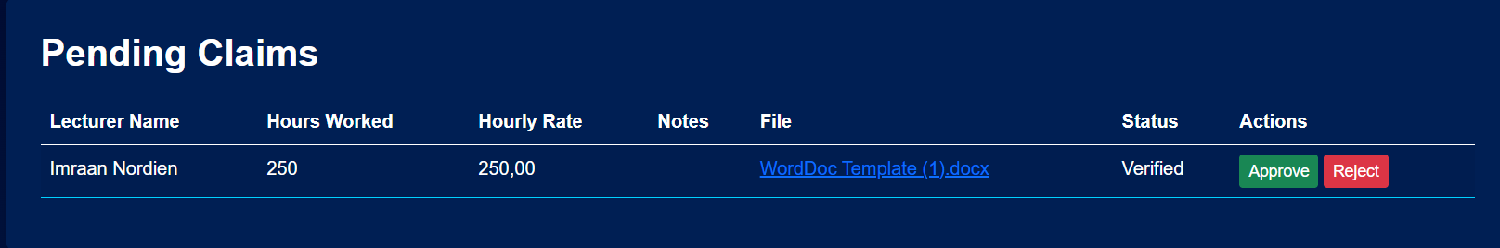
Academic Manager (AM) View
Displays Verified Claims only
Approve or Reject claims
Approved claims move to “Approved Claims” list
Prevents duplicate actions on finalized claims

Slide 9
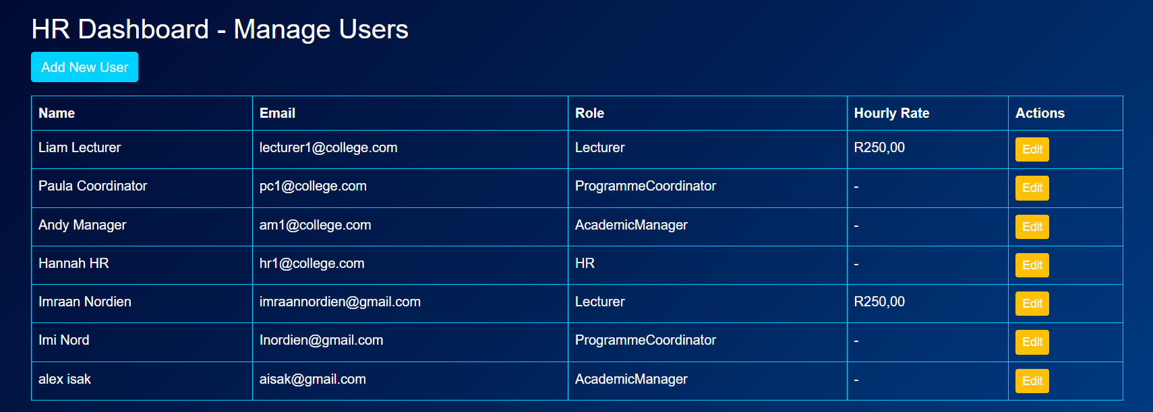
HR Dashboard
Manage all user accounts (Lecturer, PC, AM, HR)
Set hourly rates during user creation
Update passwords and details
Generate reports for Approved Claims using LINQ

Slide 10
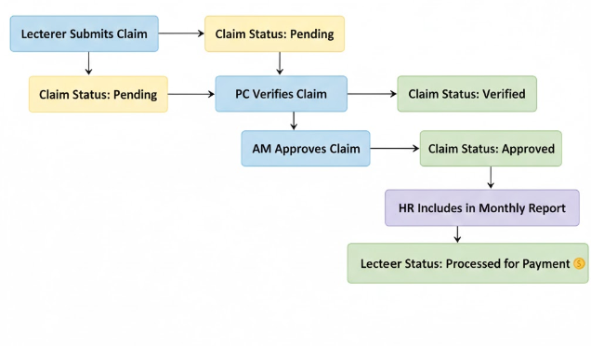
Claim Workflow
Lecturer submits claim → Pending
PC verifies → Verified
AM approves → Approved
HR includes in monthly report → Processed for payment

Slide 11
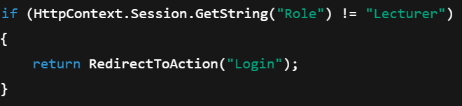
Security and Validation
Session-based role control (restrict unauthorized access)
Page-level access checks
File validation: type, size, required upload
Data validation: Hours, Rates, Required Fields
Database constraints via EF Core
Code snippet for session check:

Slide 12
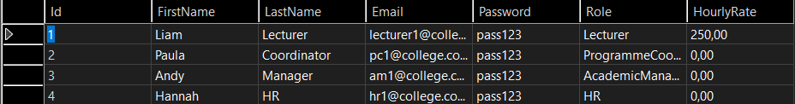
Database Integration
EF Core + SQL Server (LocalDB)
ApplicationDbContext manages Users & Claims tables
HR adds users → saved persistently
Claims linked to logged-in lecturer

Slide 13
Challenges & Solutions
Challenge | Solution
Restricting unauthorized access | Session-based role validation
Linking claims to logged-in lecturers | Use Session.UserId
Handling invalid uploads | Server-side file validation & error messages
Automating approval workflow | Separate logic for PC (verify) & AM (approve)

Slide 14
Technologies Used
Technology | Reason
HTML | Represents webpage structure
CSS | Styles your frontend
Bootstrap | Frontend framework
Razor | Templating engine in ASP.NET
ASP.NET Core MVC | Backend framework for web apps
C# | Programming language
SQL Server + EF Core | Database storage & ORM
Session-based access | Security/authentication

Slide 15
Demonstration Video
YouTube Link:
Highlights: Role-based login, claim workflow, HR dashboard, report generation

Slide 16
Conclusion
Fully automated contract claim workflow
Role-based, secure access control
Enhanced validation and error handling
Centralized HR management
Realistic and scalable implementation

Slide 17
Thank You
Imraan Nordien
Student No: ST10434419
Student Email: ST10434419@vcconnect.edu.za
GitHub Repository Link:
https://github.com/ImraanNordien/St10434419_PROG62121_POE_Part3.
YouTube Demo Link: https://youtu.be/xvriFYxKQWY

